Slide 1



UNIT 1
Look back 1
Part 3

Slide 2
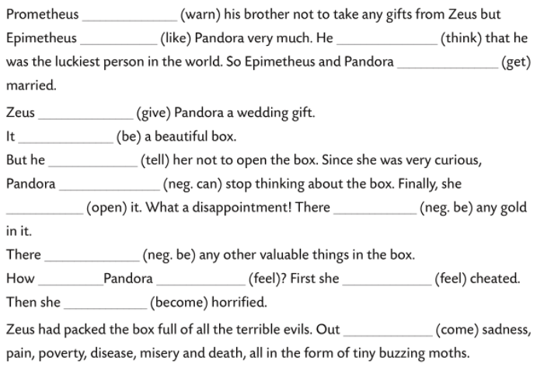
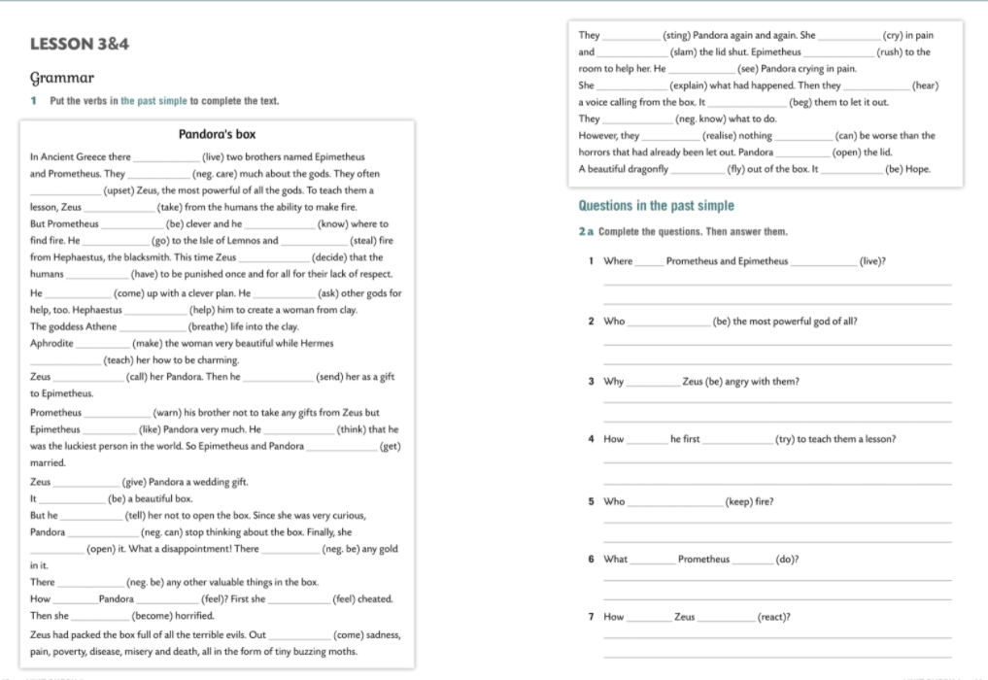
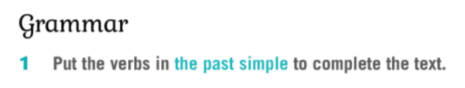
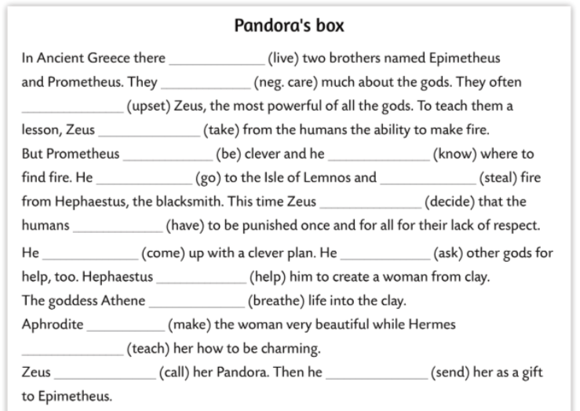
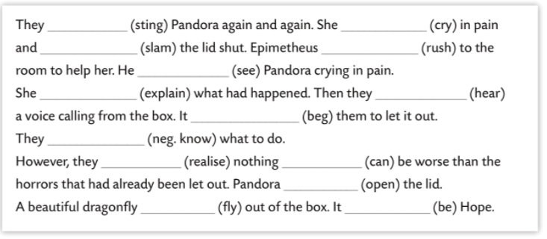
warned
liked
thought
got
gave
was
told
couldn’t
opened
wasn’t
weren’t
lived
did
feel
felt
didn’t care
became
upset
came
took
was
knew
went
stole
stung
cried
decided
slammed
had
rushed
saw
came
asked
explained
heard
helped
begged
breathed
didn’t know
made
realised
could
taught
opened
called
sent
flew
was

Slide 3
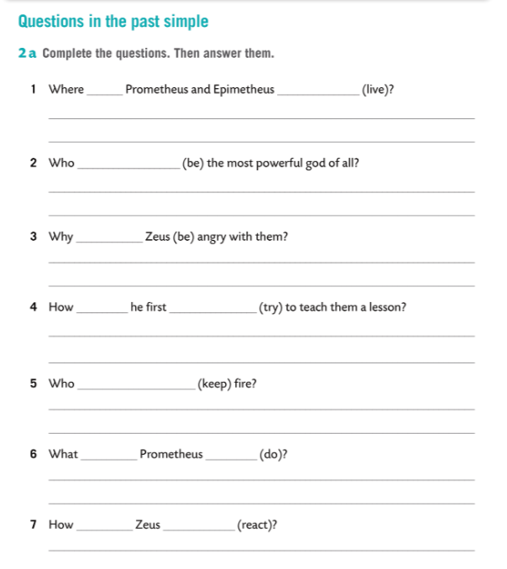
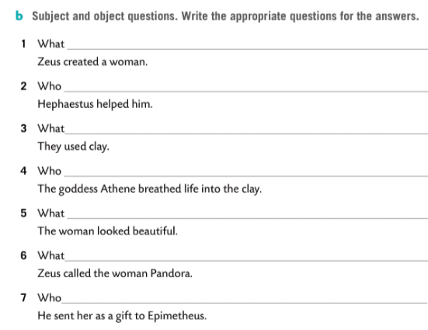
did Zeus create?
did
live
helped him?
In Ancient Greece.
did they use?
was
Zeus.
breathed life into the clay?
was
did the woman look like?
Because they didn’t care about gods.
did Zeus call the woman?
did
try
did he send her to as a gift?
He took from the humans the ability to make fire.
kept
Hephaestus.
did
do
He stole fire from him.
did
react
He decided to punish them once and for all.

Slide 4
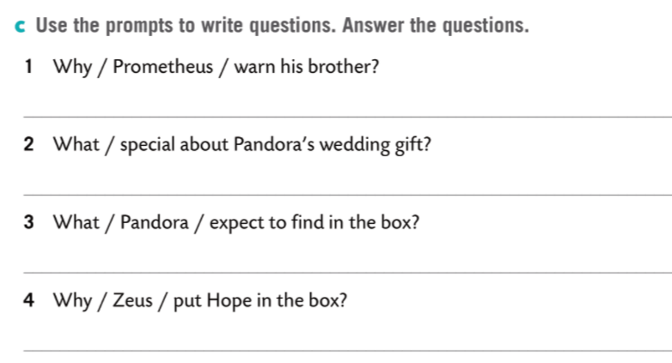
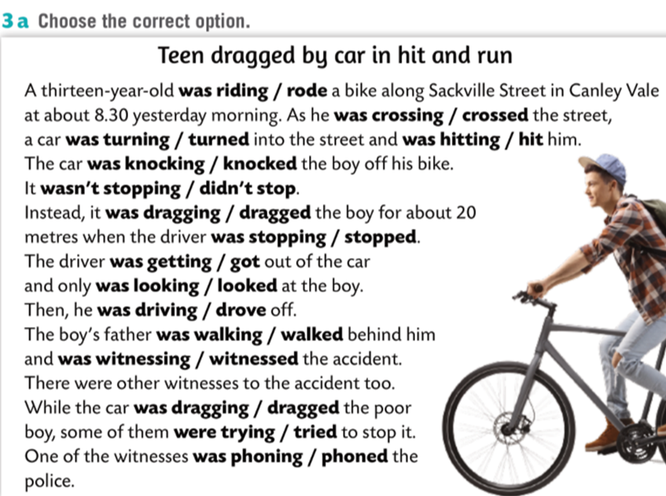
Why did Prometheus warn his brother?
Because he knew that Zeus was angry.
What was special about Pandora’s wedding gift?
It was a box but he told her not to open it.
What did Pandora expect to find in the box?
She expected to find gold.
Why did Zeus put Hope in the box?
He wanted to give people a chance.

Slide 5
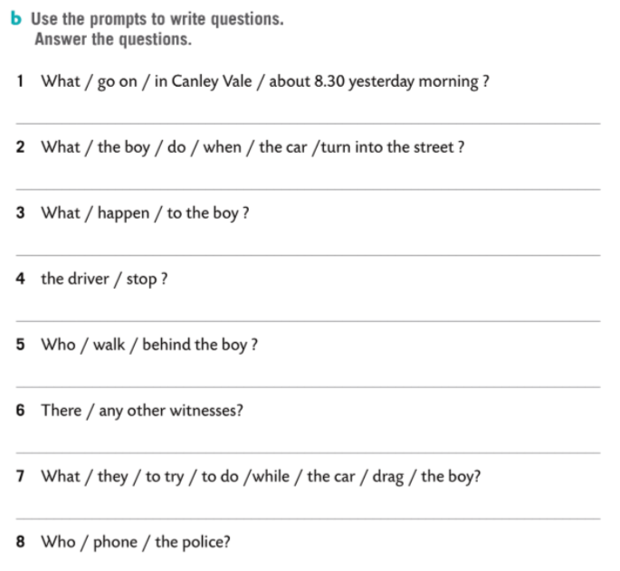
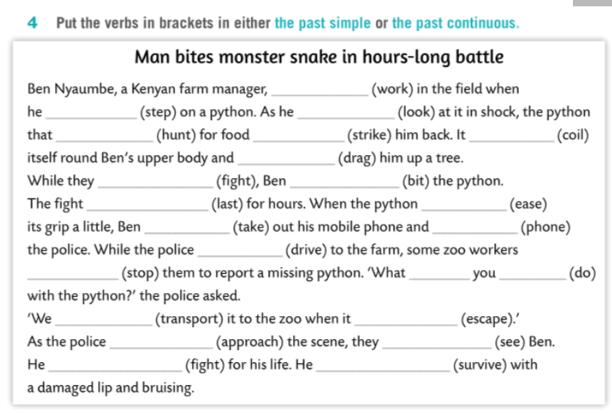
A 13-year-old boy was riding his bike.
The boy’s father.
He was crossing the street.
Yes, there were.
The car hit him.
They were trying to stop the car.
What was going on in Canley Vale about 8.30 yesterday morning?
No, he didn’t.
One of the witnesses.
What was the boy doing when the car turned into the street?
What happened to the boy?
was working
stepped
was looking
Did the driver stop?
was hunting
struck
coiled
dragged
Who was walking behind the boy?
were fighting
bit
lasted
eased
Were there any other witnesses?
took
phoned
were driving
stopped
were
doing
What were they trying to do while the car was dragging the boy?
Who phoned the police?
were transporting
escaped
were approaching
saw
was fighting
survived

Slide 6
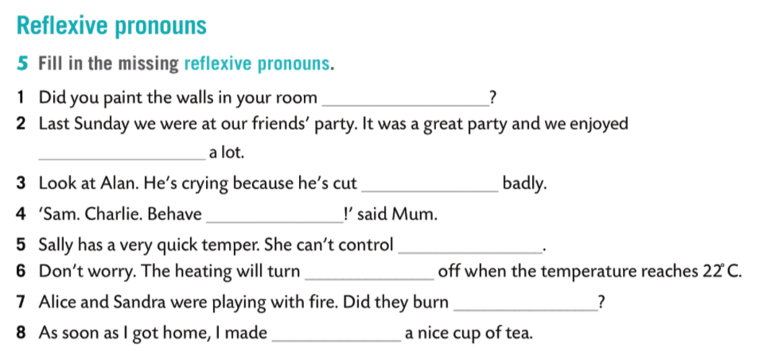
yourself
ourselves
himself
yourselves
herself
itself
themselves
myself

